Slide 1
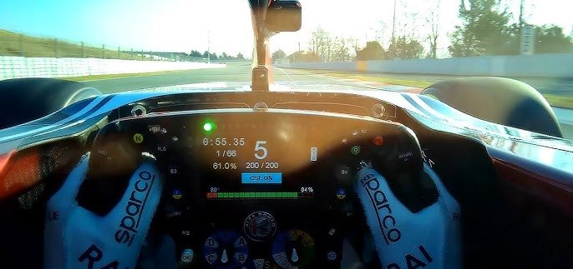
SD 2 – Team 17 Pneumatic Paddle Shifting
Margaret Allen, Justin Lischuk, Kaci Walter, Jakob Werle

Slide 2
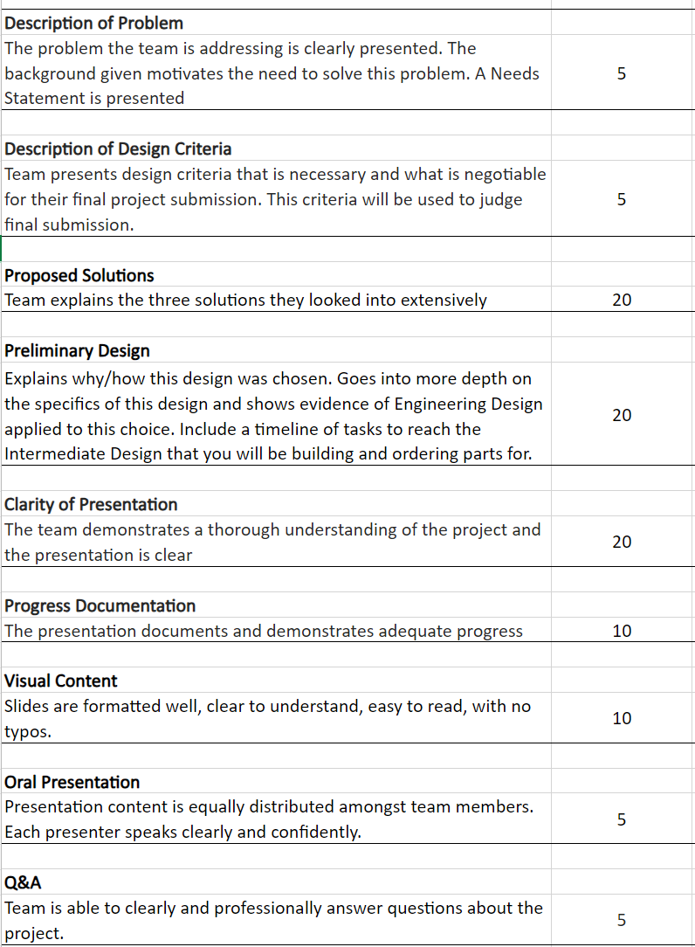
PPT Plan

Slide 3
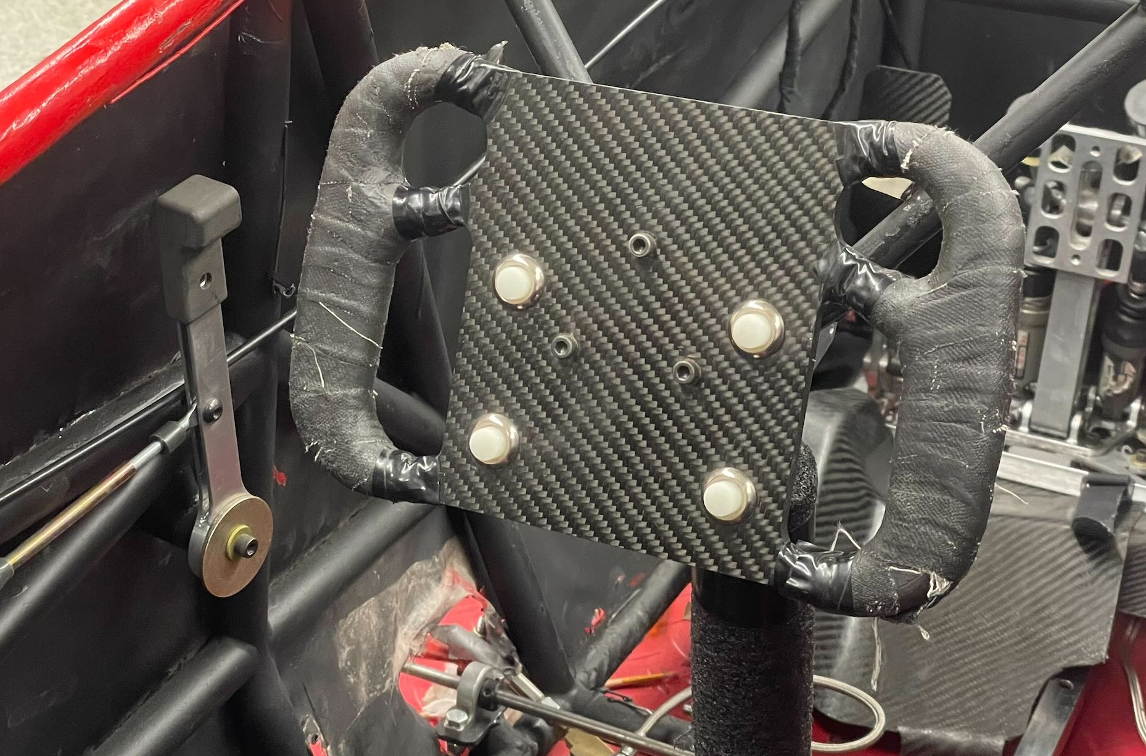
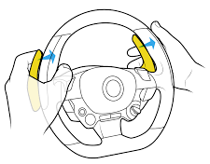
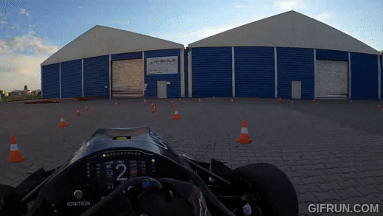
Project Overview
FSAE competition
Demands 50+ shifts per lap
0.5s slower per turn than 1st (FSAE Endurance results 22’ & 23’)
Replace manual shift system
One hand lever → finger paddles
Safety & focus improvements
Develop system on testing bench
Correlate data to components
Provide design platform for TFR
Notes:
https://www.youtube.com/watch?v=AlR21hu3b6Q
Engineering competition testing student-built vehicle’s capabilities

Slide 4
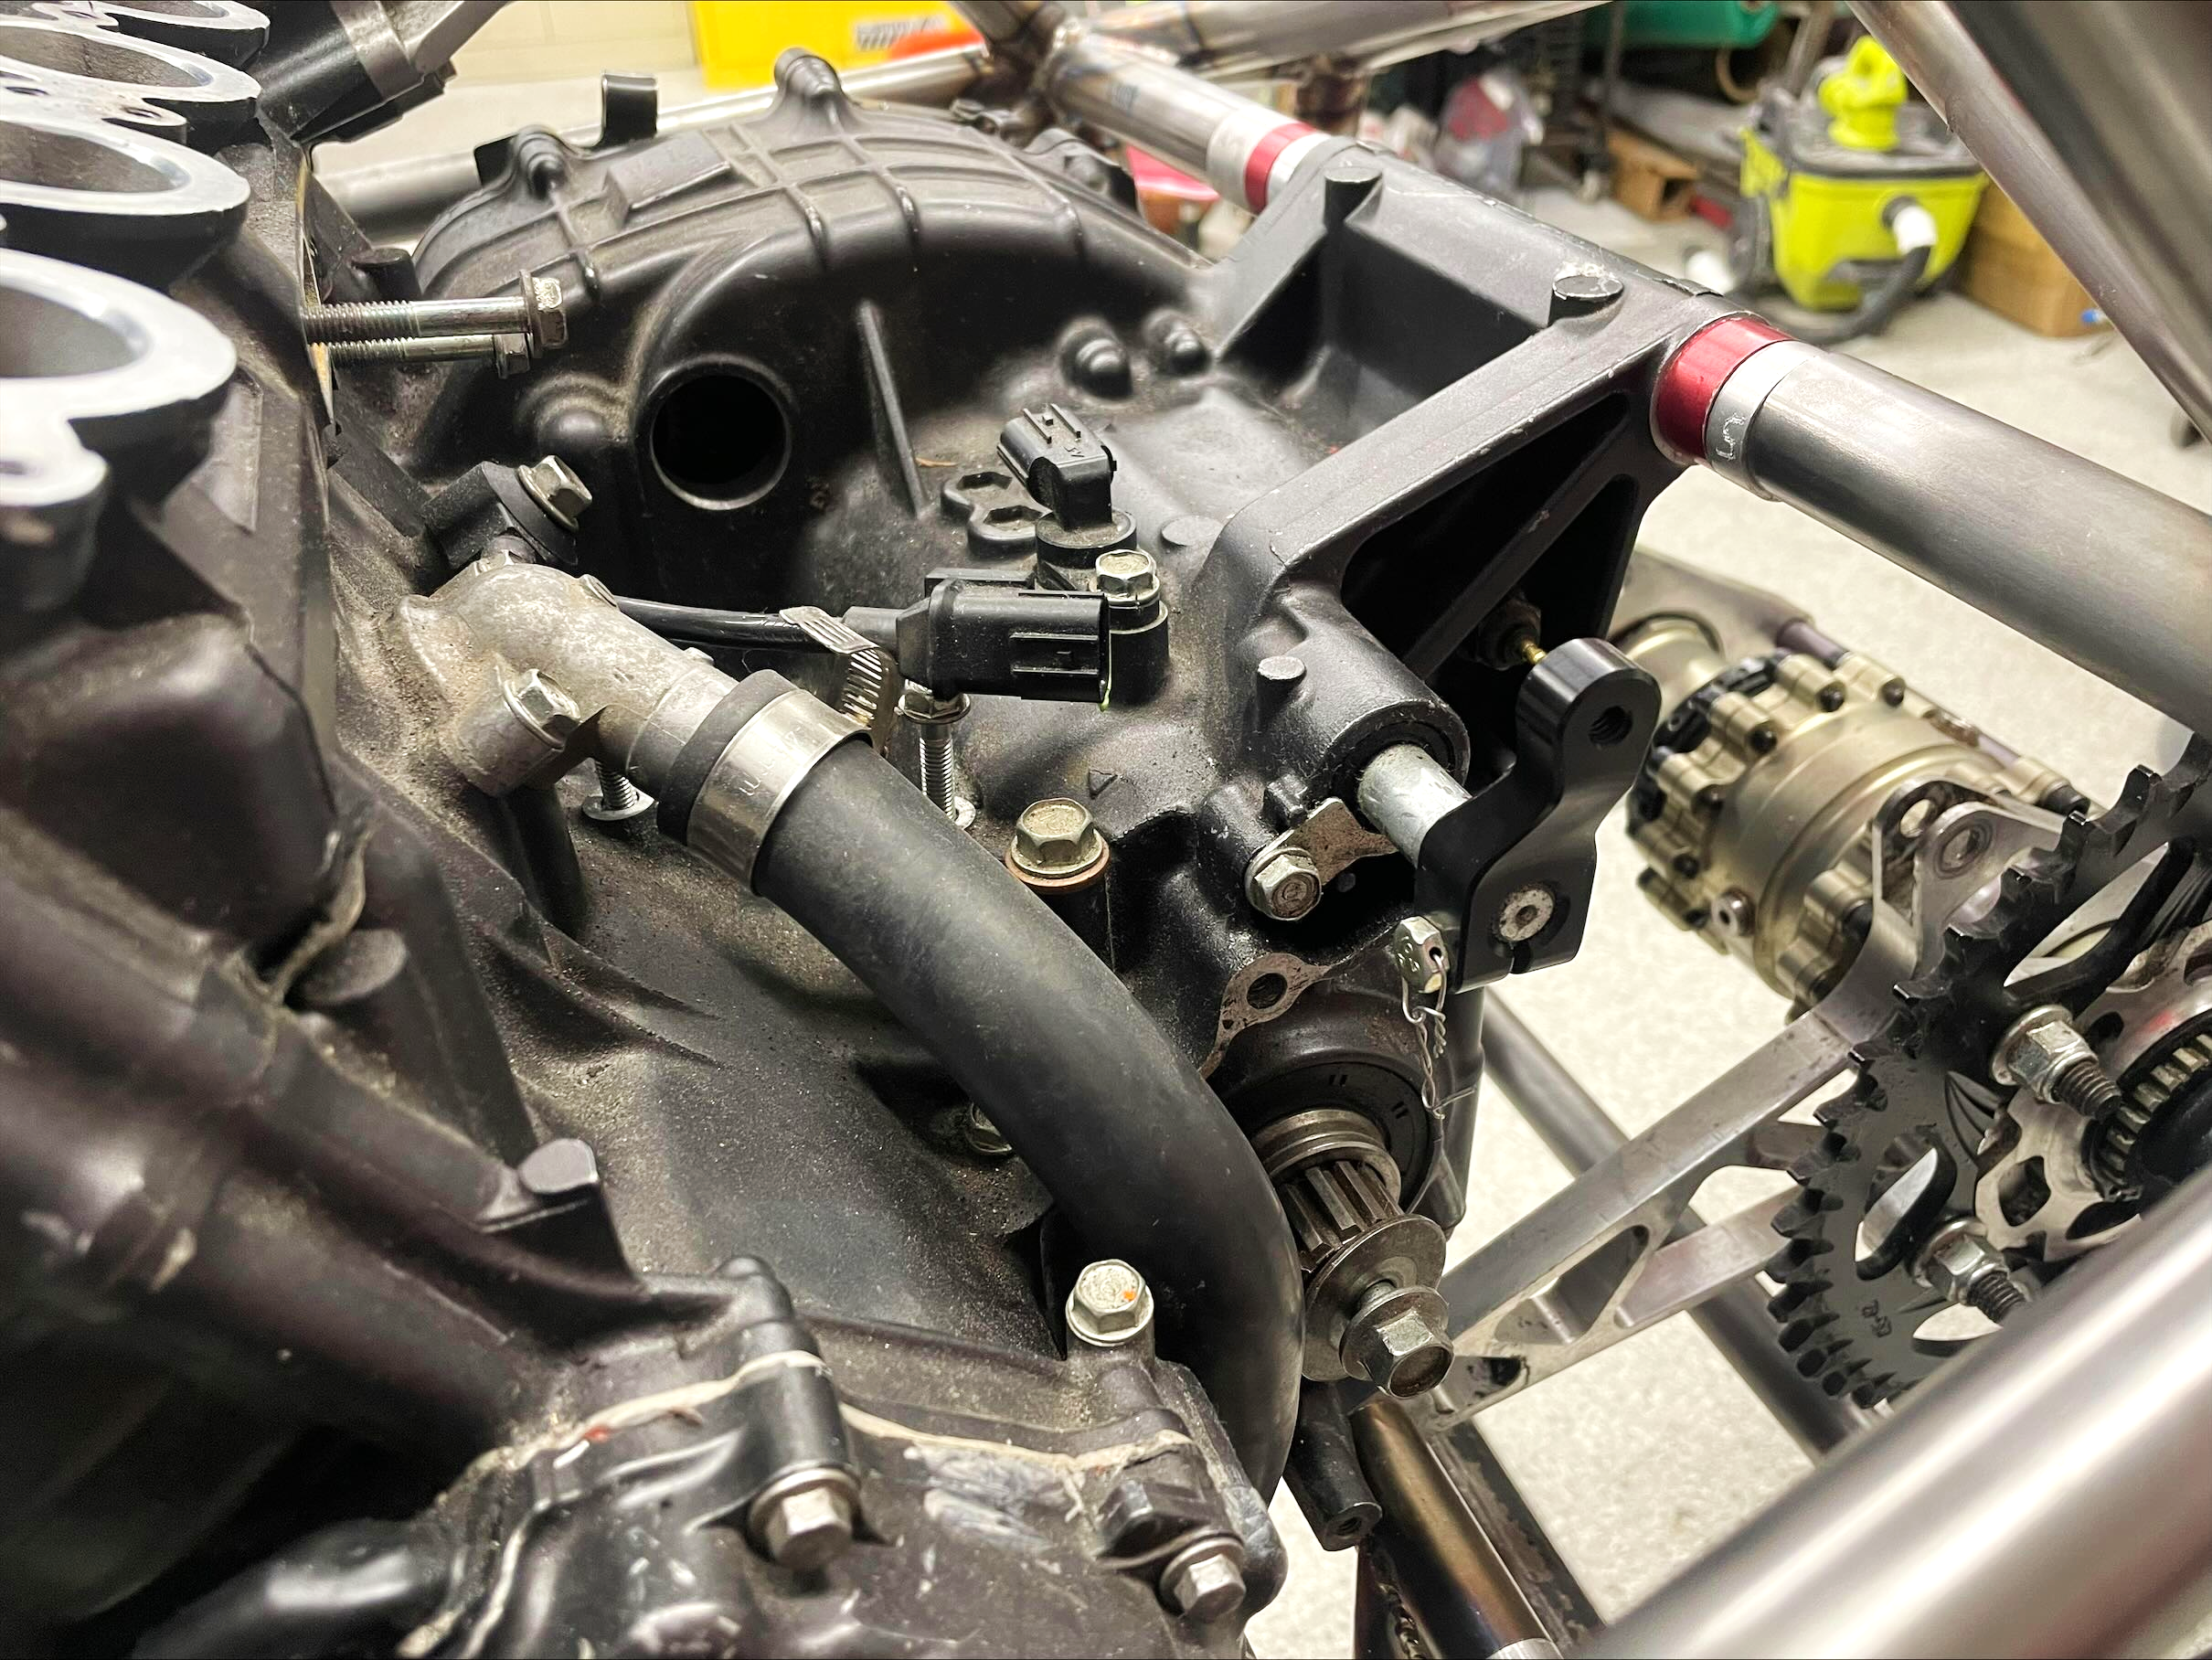
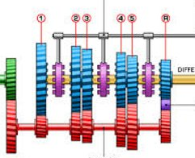
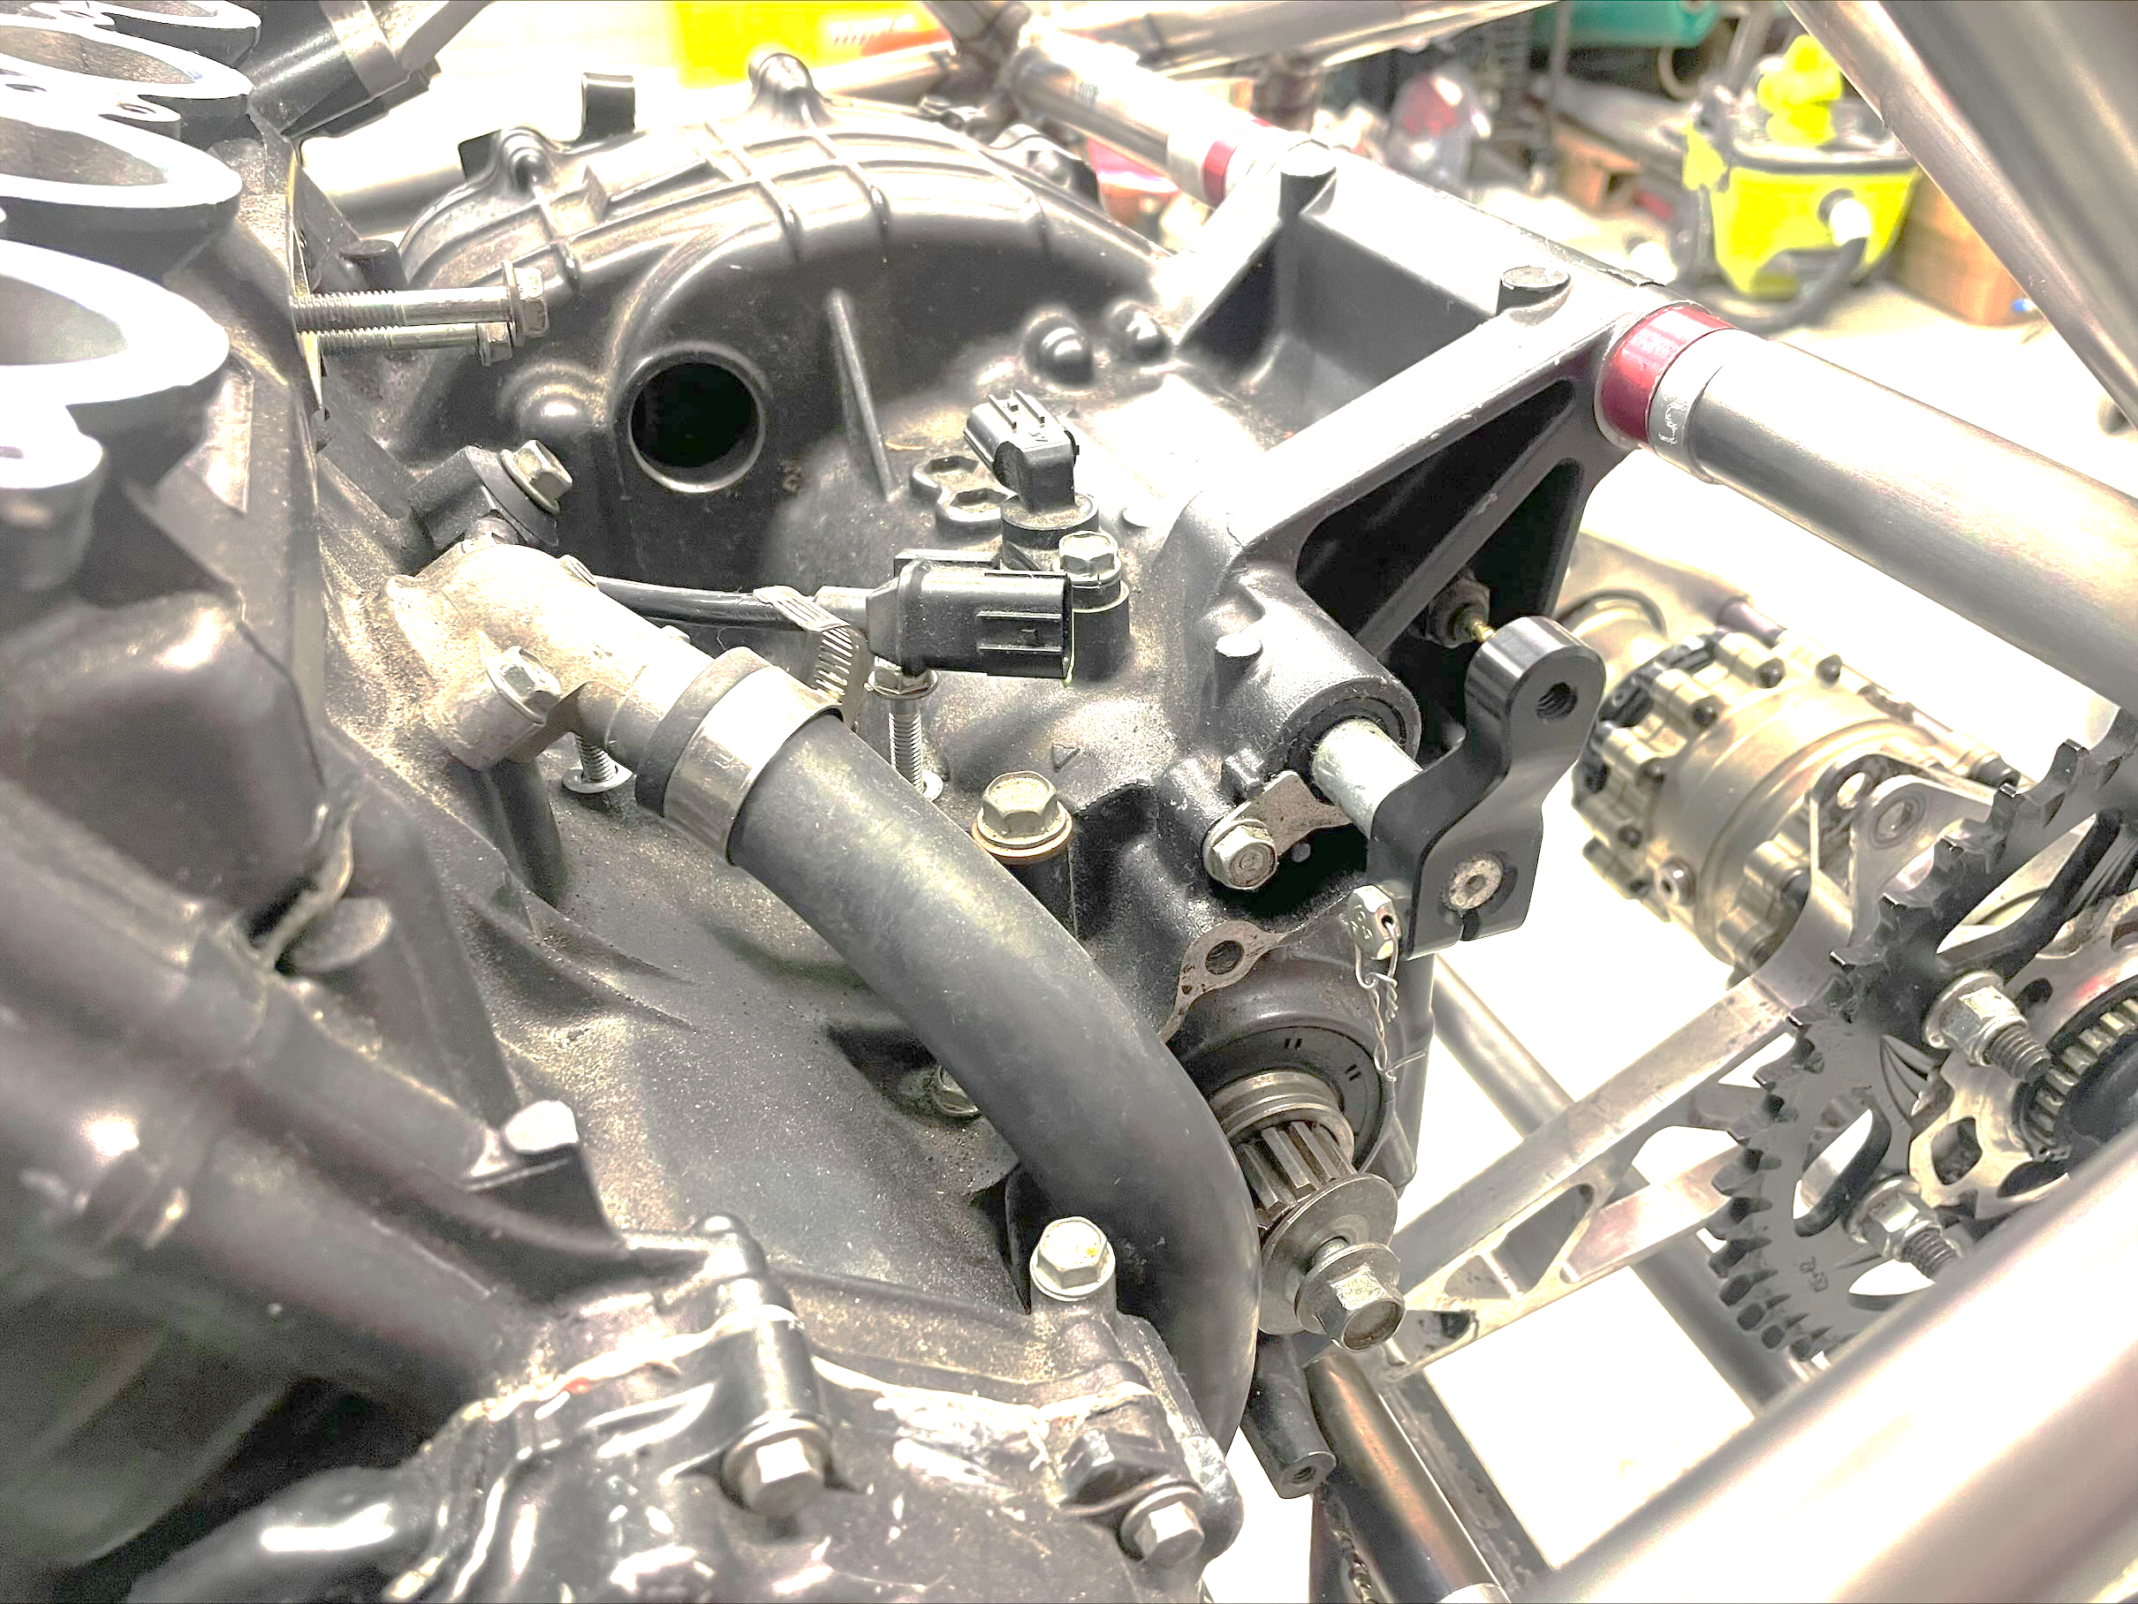
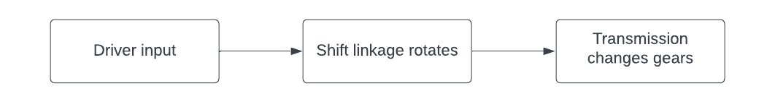
Problem Description
Shifting mechanism constraints:
Rotate shifting linkage minimum engagement distance ~ 0.4”
Provide enough force/torque to engage transmission ~ 90lbs
Provide repeatable shift every ~ 0.3s
Operate on 12V battery

Slide 5
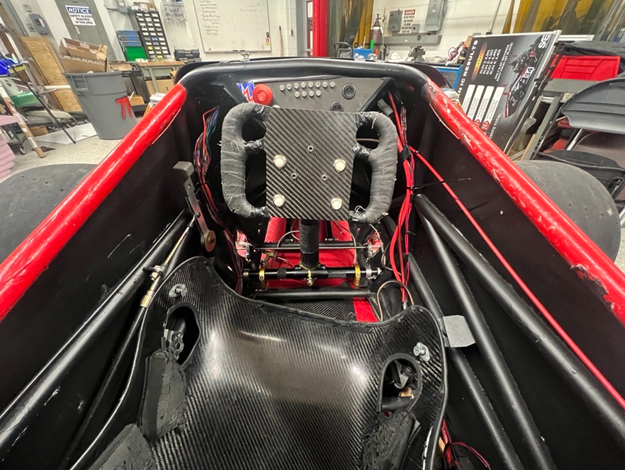
Problem Summary
1. Design automated shift actuation system to replace mechanical system
2. Construct apparatus to test components in operating conditions
3. Utilize testing data to formulate optimization plans

Slide 6
Design Constraints
Priority | Design Constraint | Metric | Target | Justification
Non-negotiable | Rules Compliance | A pressure regulator must be mounted directly onto a gas cylinder/tank | Pass/Fail | Formula SAE Rules
Non-negotiable | Rules Compliance | The gas lines and fittings must be appropriate for the maximum possible operating pressure of 121 psi | <121 psi | Formula SAE Rules
Non-negotiable | Rules Compliance | The working gas must not be flammable | Pass/Fail | Formula SAE Rules
Non-negotiable | Rules Compliance | All pressurized cylinders must be commercially manufactured | Pass/Fail | Formula SAE Rules
Non-negotiable | Integration | All electrical components should be compatible with TFR battery and Ecu | Pass/Fail | Usability
Negotiable | Aesthetically Pleasing | Design is sleek and cohesive | 80% of polled individuals find the design to be aesthetically pleasing | SAE competition points

Slide 7
Functional Requirement
Priority | Functional Requirement | Metric | Target | Justification
Non-negotiable | Air cylinder actuation must produce enough torque to shift gears | Up-shift, down-shift, neutral | [90,90,3] lbs | Client
Non-negotiable | Time/delay between shifts | Timer on microcontroller | 1 shift every 0.3 seconds | Client
Non-negotiable | Total quantity of shifts per tank | Total amount of shifts per endurance race | >500 shifts | Client
Non-negotiable | Improve vehicle performance | Shifting time | Decreased by 5% | SAE Competition points
Non-negotiable | Systems integration | Microcontroller to facilitate input and output interactions | Pass/Fail | Client
Non-negotiable | Data displayed after each shift | Dashboard | Pass/fail | Data processing
Non-negotiable | Integration | Shifting lever should not go beyond length of original manufacturer design | 1.5 inches | Client
Negotiable | Mechanism weight | Weight | <10 lbs | Client

Slide 8
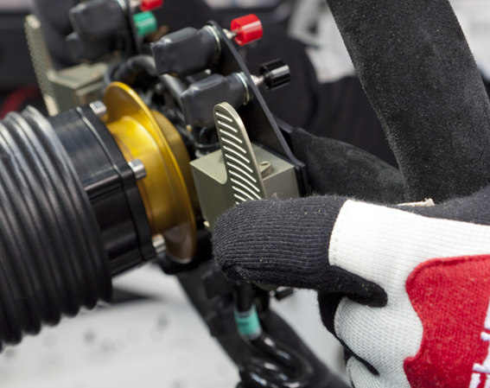
Proposed Solutions

Slide 9
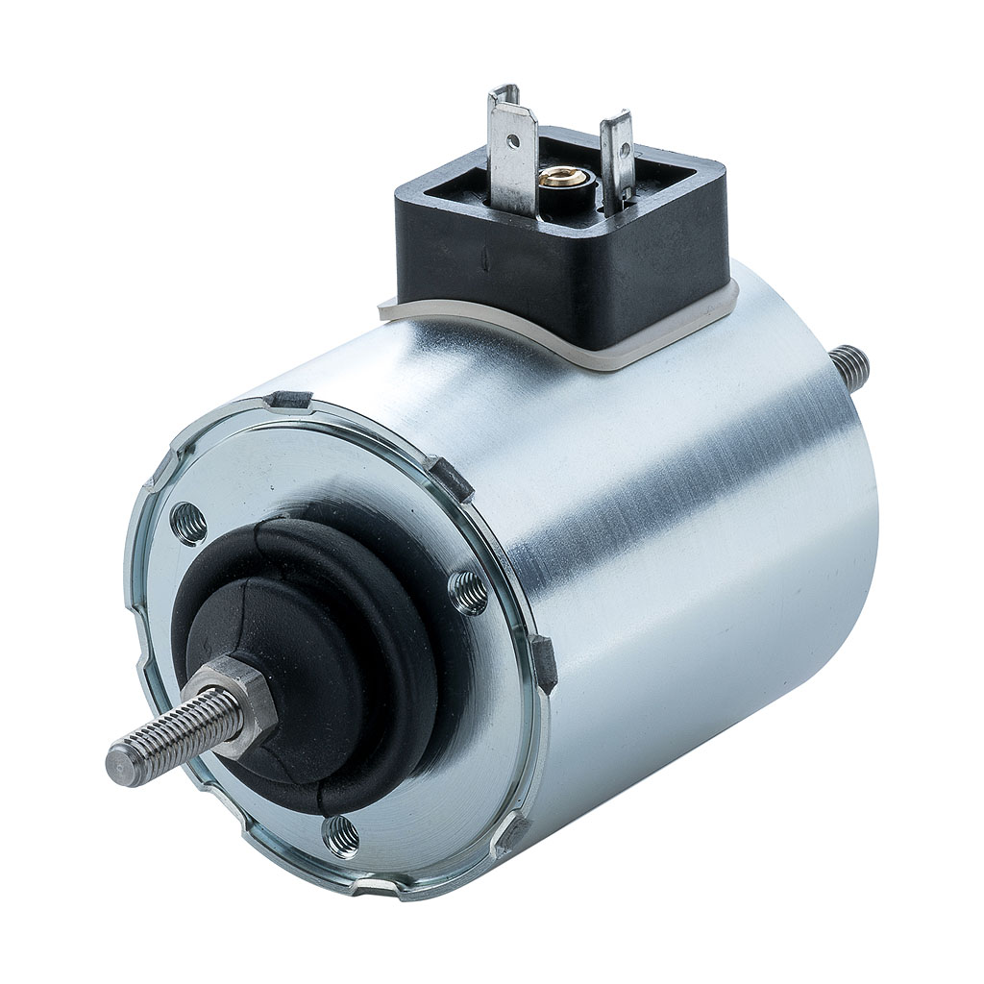
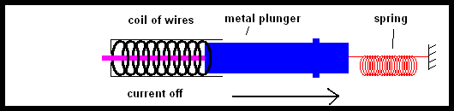
Proposed Solution 1: Pure Electric
Actuation of lever by pushing magnetic plunger through center of solenoid
Induced current creates electromagnet that pushes magnetic material, and spring relaxes plunger back to original state when current is off
Simplest design
High electrical energy consumption > 5 A
Limited capacity in an on-car battery < 250 Ah
Linear Electric Solenoid
Electric Solenoid Functionality

Slide 10
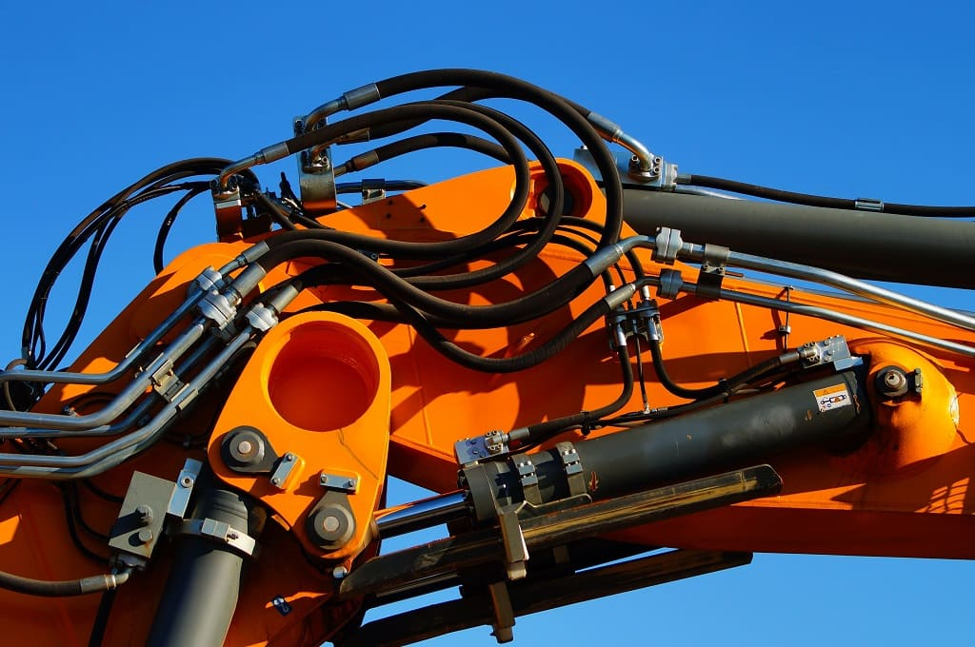
Proposed Solution 2: Electro-Hydraulic
Actuation of piston through hydraulic fluid and system of pump and motor
Paddles would act as switches to signal microcontroller to activate pump, motor and hydraulic cylinder
Require high operation pressures > 500 psi
Heavy components
More parts = more complexity
Hurdles with FSAE rules
Known for difficult sealing and mess
Hydraulic Lift
Notes:
vehicle braking system, hydraulic lift at construction sites, car jacks, etc. Improper seal could prevent system from holding pressure

Slide 11
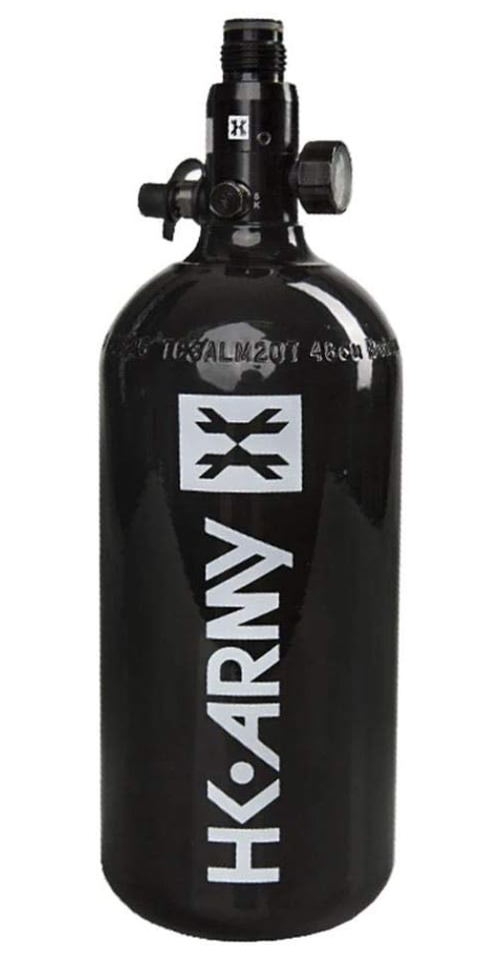
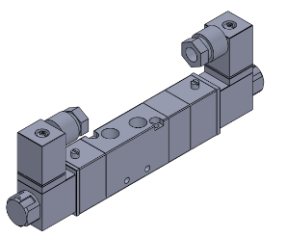
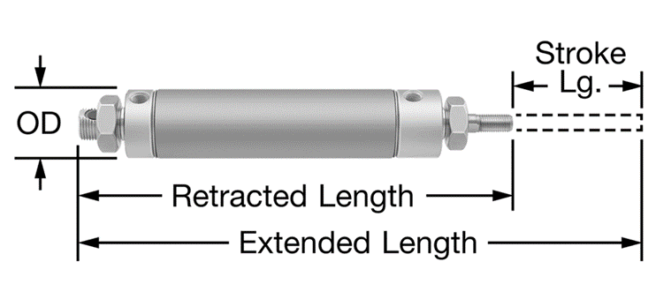
Proposed Solution 3: Electro-Pneumatic
Actuation of shift utilizing pneumatic cylinder
Components: Gas tank, Pneumatic Cylinder, Pneumatic Solenoid Valve
All components < 10lbs
Low operating pressure < 121psi → reliable, low maintenance
Easy integration to existing shifting system
Gas Tank
Solenoid Valve
Pneumatic Cylinder

Slide 12
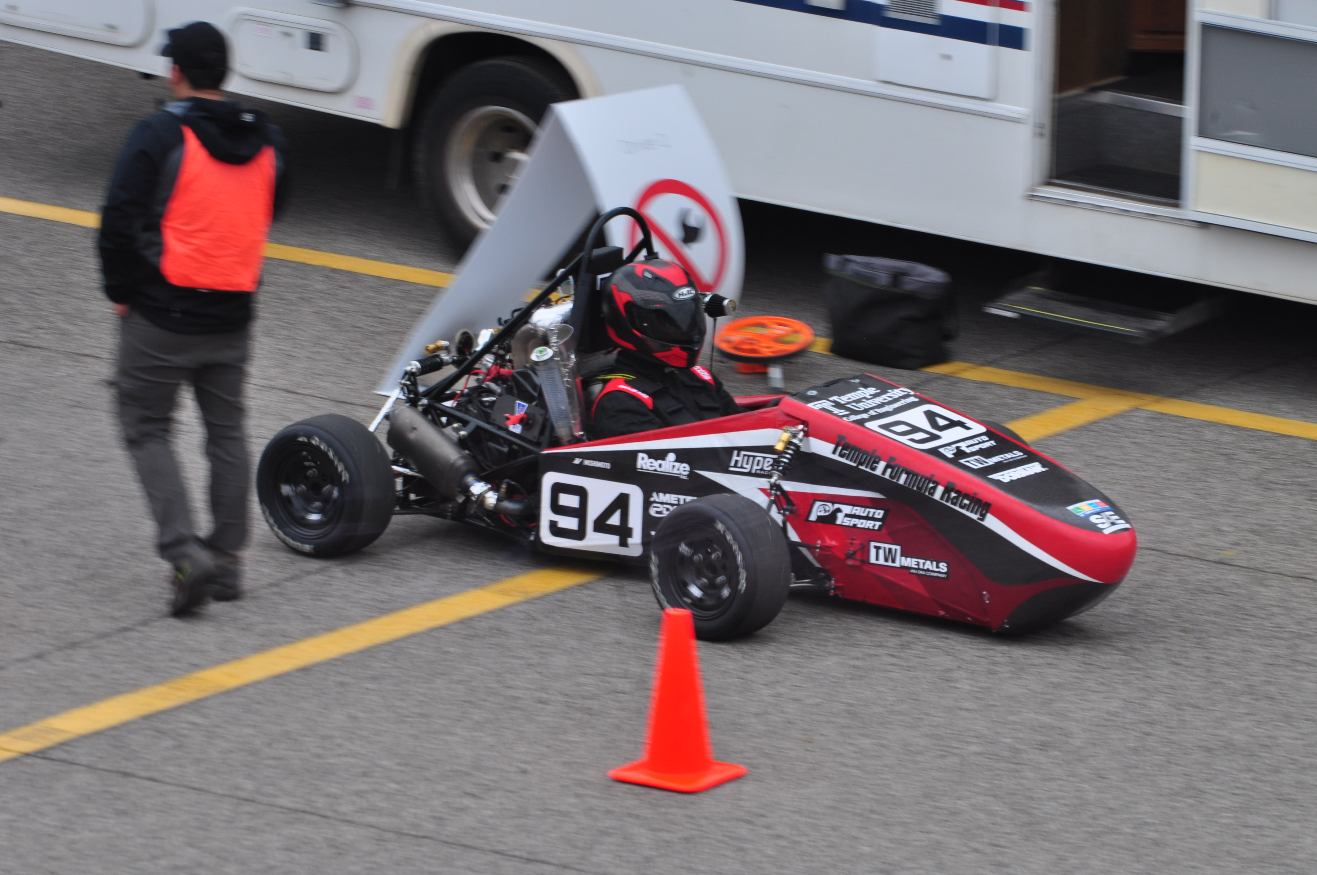
Preliminary Design
Final selection: Electro-pneumatic system
Reasoning:
Light Weight < 10lbs
Simple Design
Low pressure < 121 psi
Reliability
Maintenance
Implementation

Slide 13
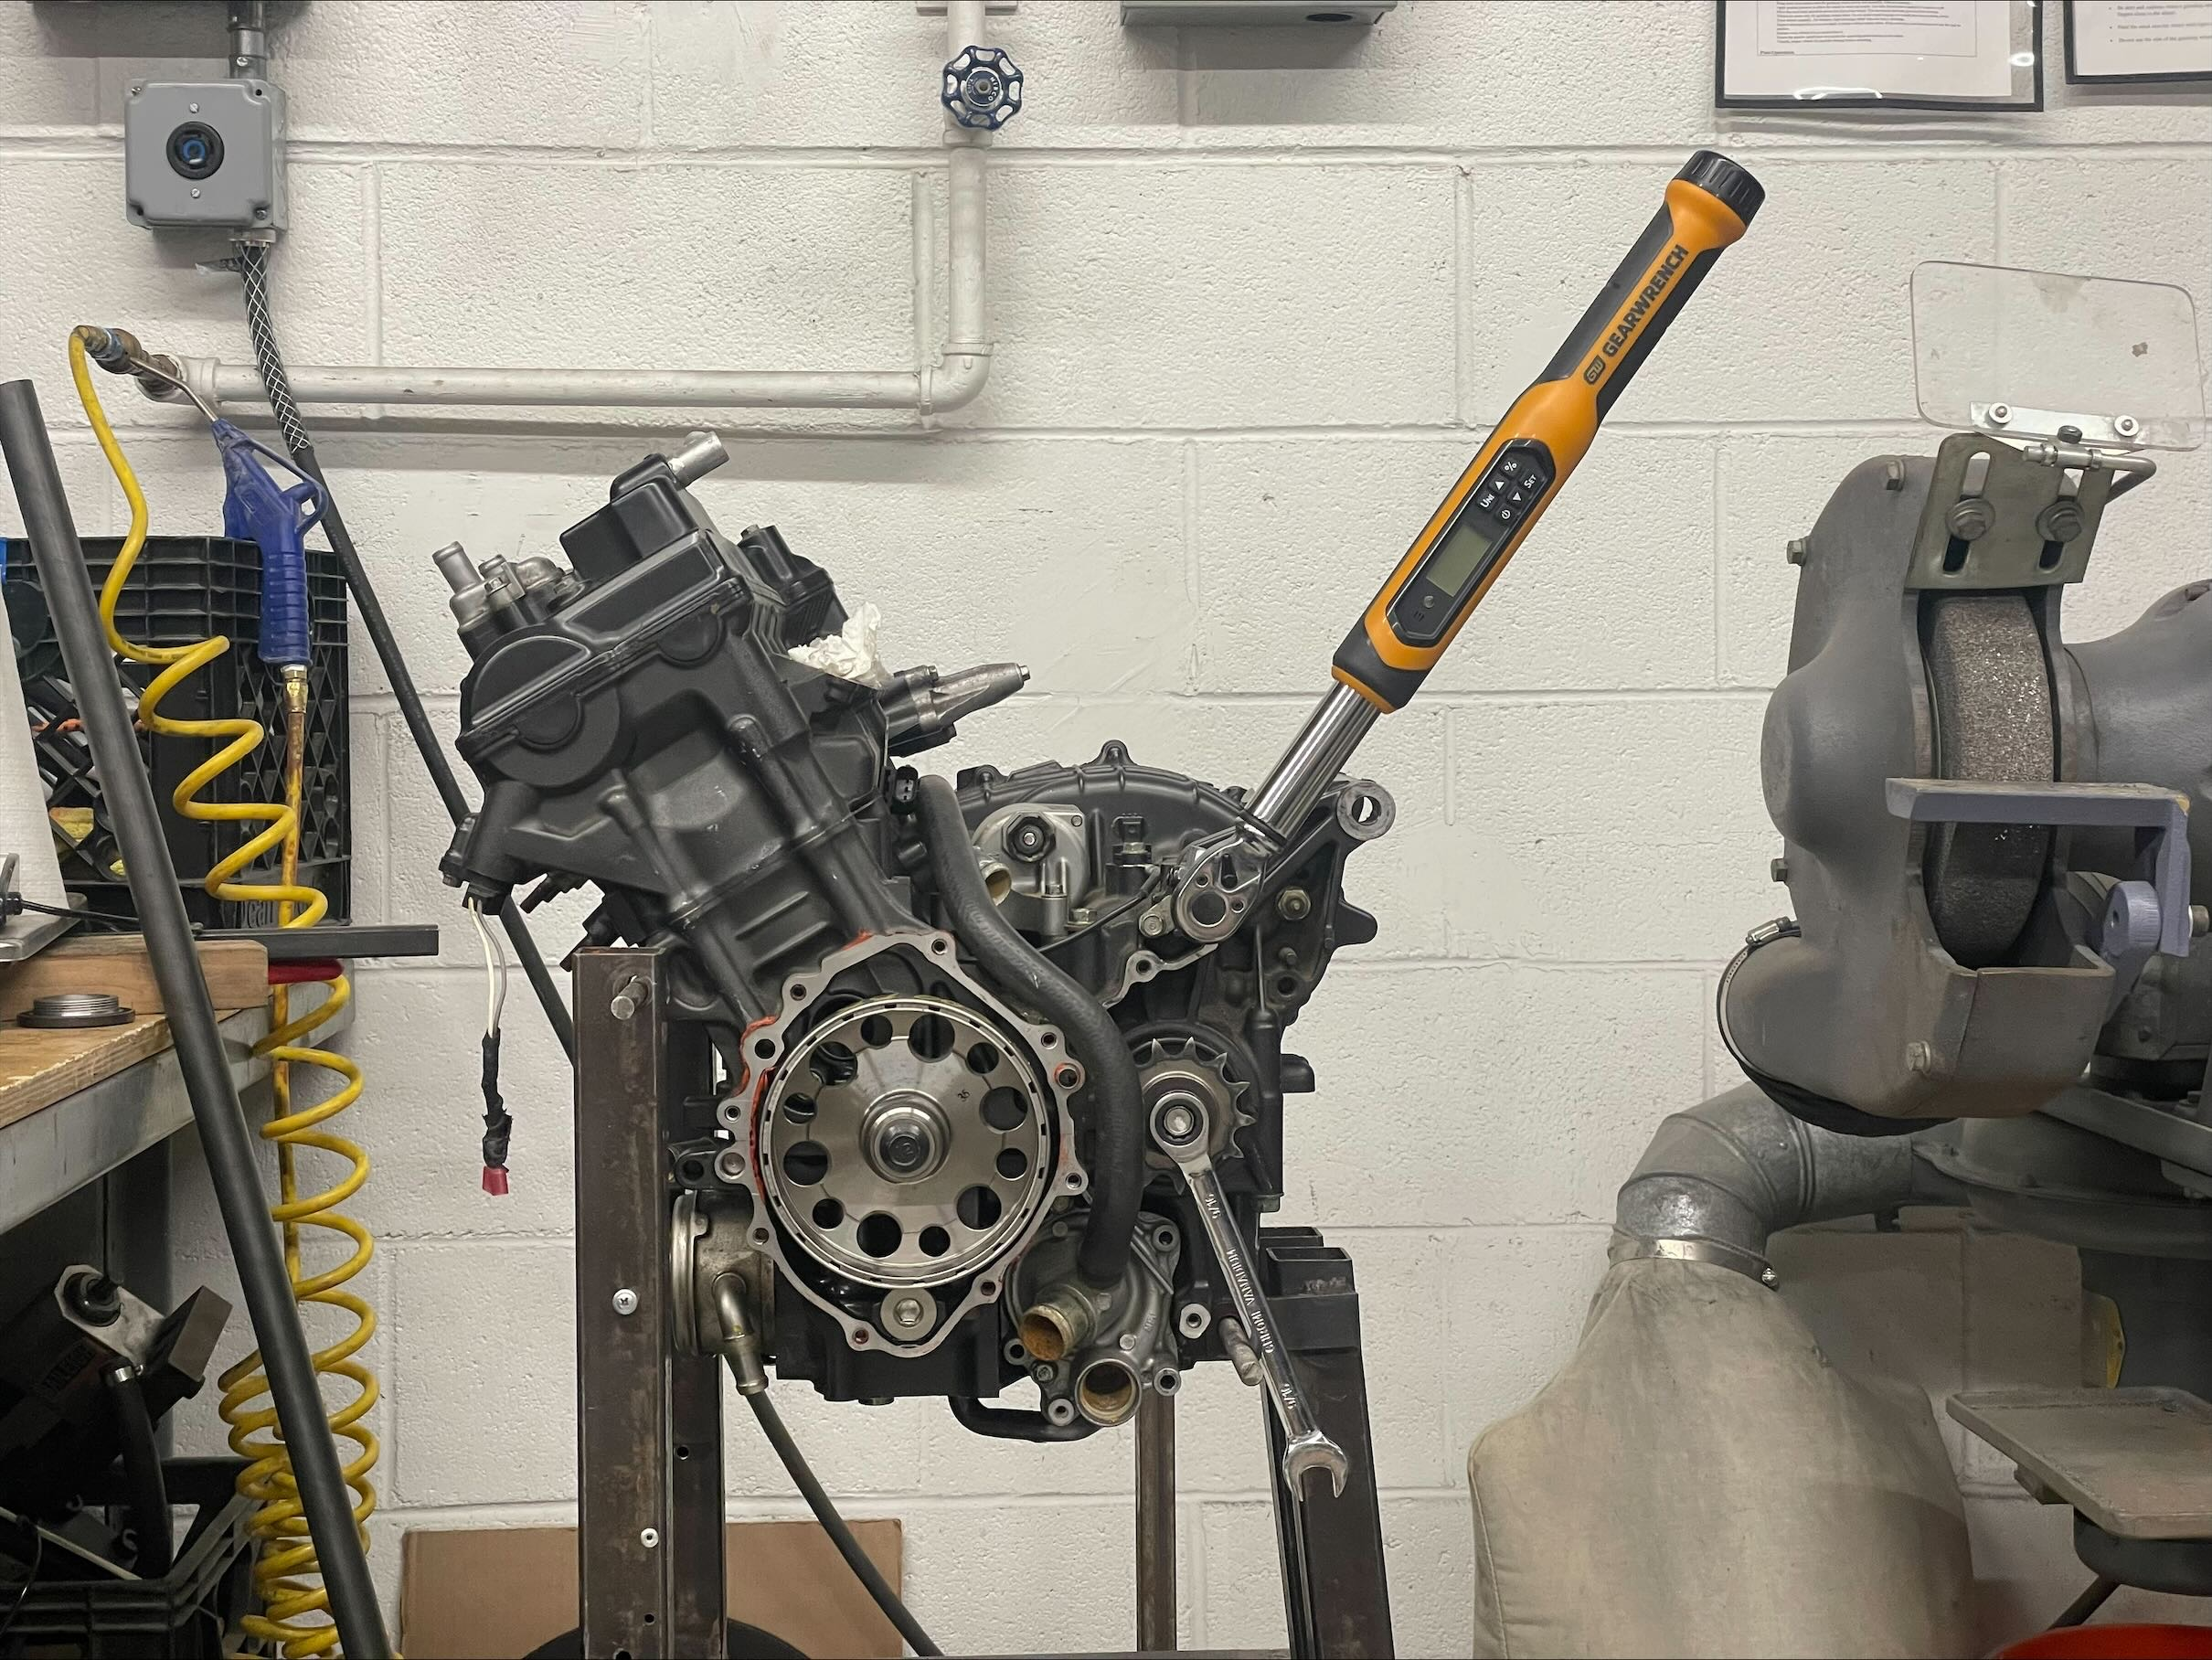
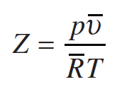
Preliminary Design
Design steps:
Experimentally define criteria
Component calculations
Actuation force calc
Air volume calc
Valve timing calc
Select Components
Assemble and Prototype
Torque Testing Apparatus
Equation: Compressibility Factor

Slide 14
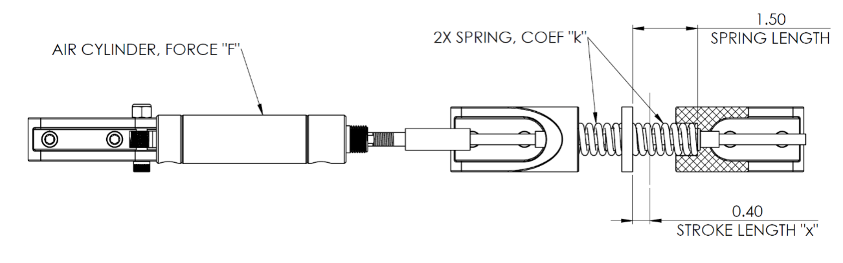
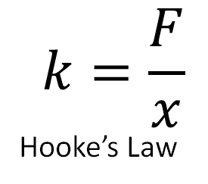
Testing Apparatus Design
Use shifting test data (see appendix)
Select spring to replicate engine forces
Validate components using FEA
$$k=\frac{F}{x}$$
Hooke’s Law

Slide 15




Immediate Tasks
Margaret | Kaci | Justin | Jakob
CO₂ calculations, tank selection | Organize agenda for weekly meetings and manage team ordering | Calibrate pressure and temperature sensors | Experimentally determine shifting criteria
Select Gas Lines | Perform calculations for N2 gas | Confirm functionality of solenoid | Complete 3D model of testing apparatus
Contact vendor for pressure regulator selection | Correspond with vendors and potential project sponsors | Begin development of Arduino driver script | Validate mechanical components using FEA
 | Select sensors |  | Order test bench supplies

Slide 16
Questions?

Slide 17
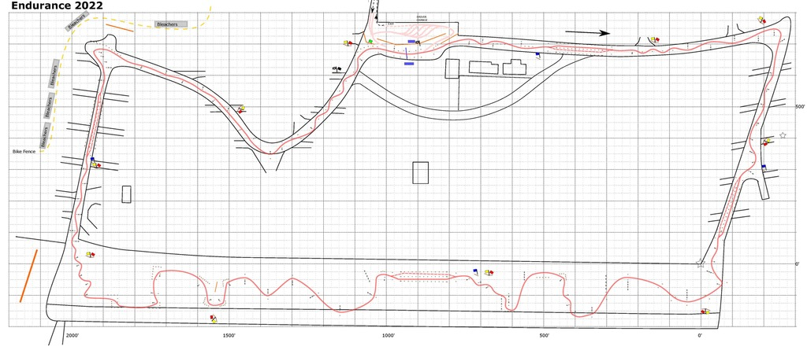
Appendix
FSAE Michigan 2022 – Endurance Track Map

Slide 18
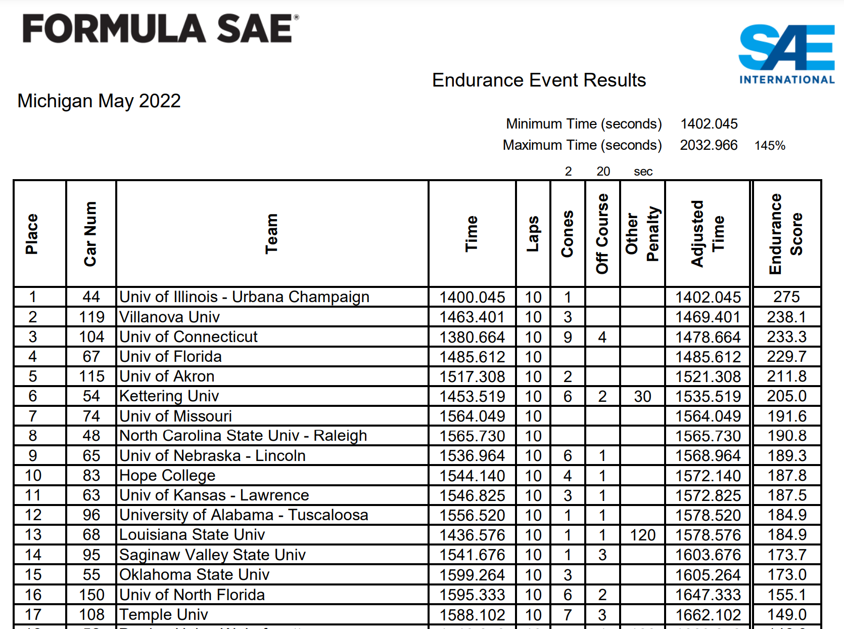
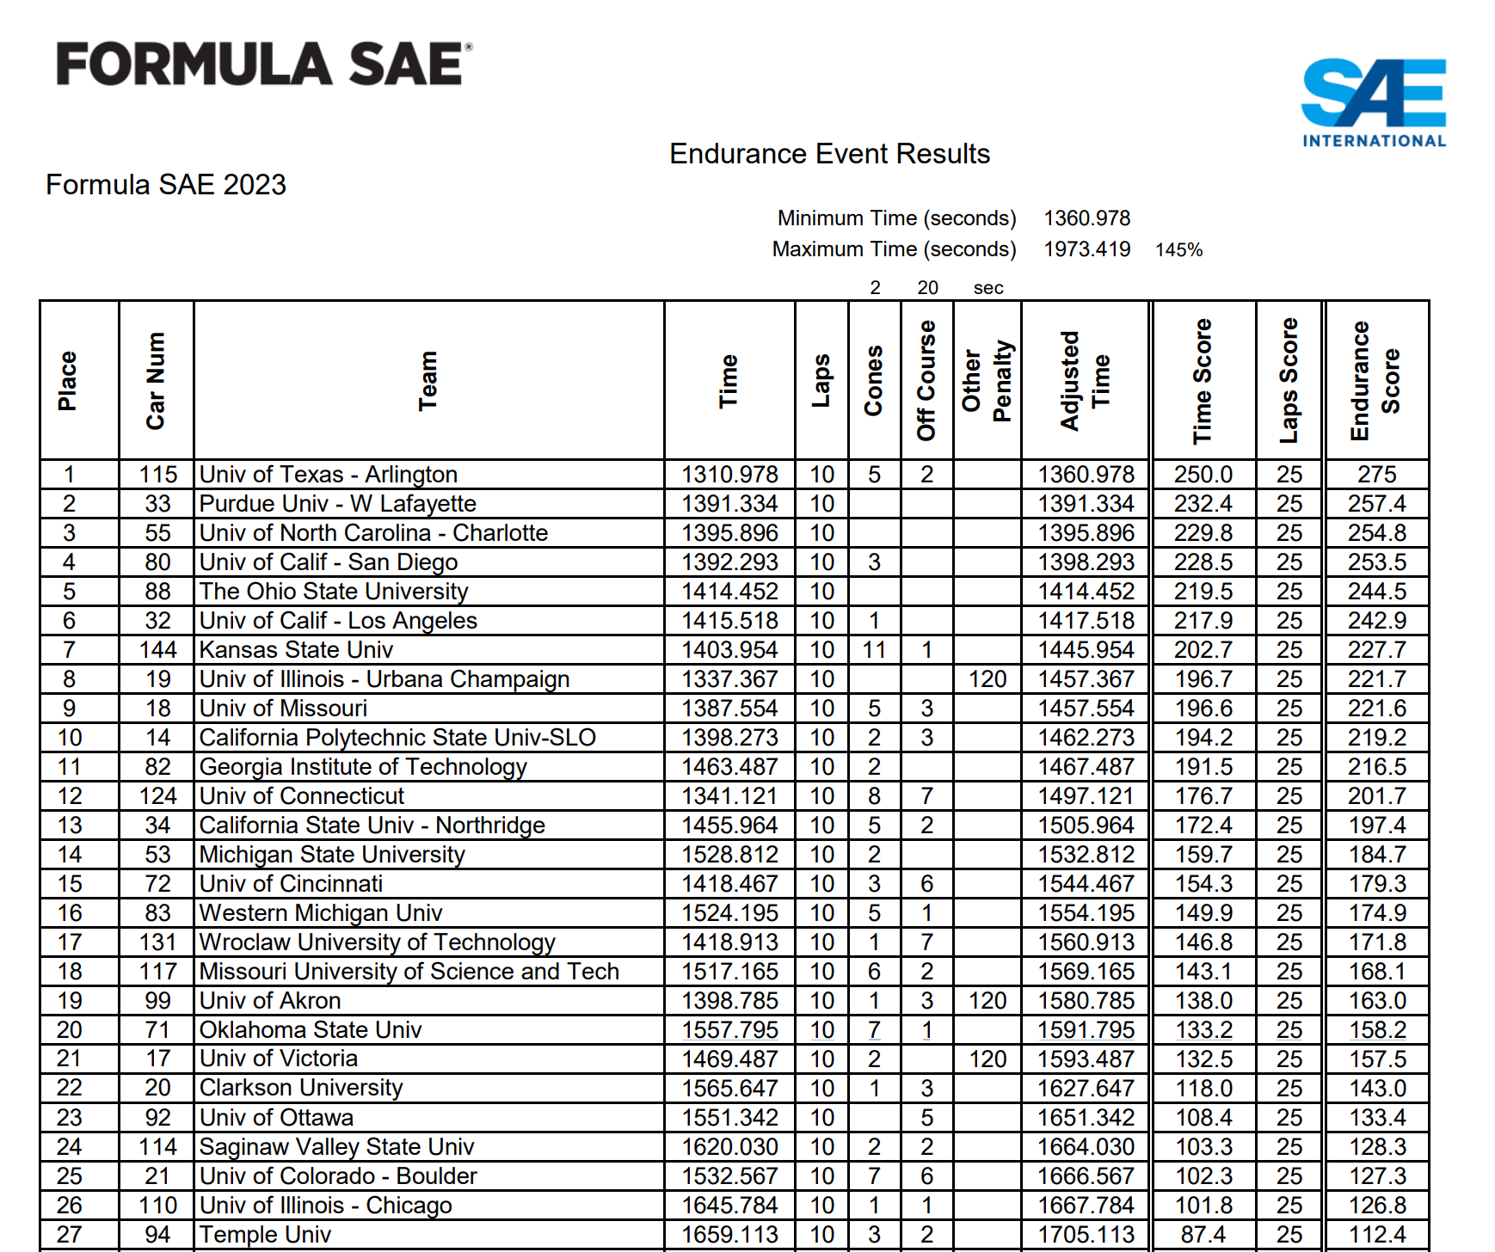
Appendix
FSAE Michigan 2022 & 2023 – Endurance Results

Slide 19
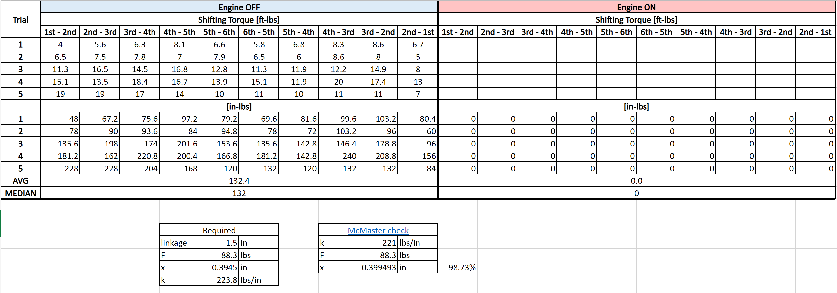
Appendix
Shifting Torque Test Results

Slide 20
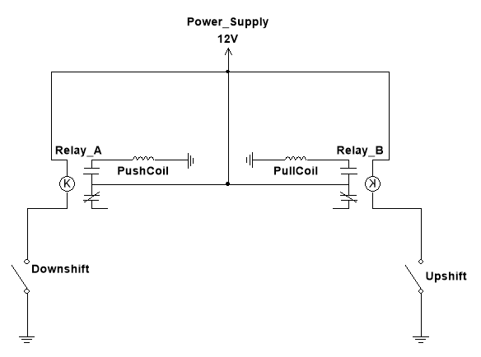
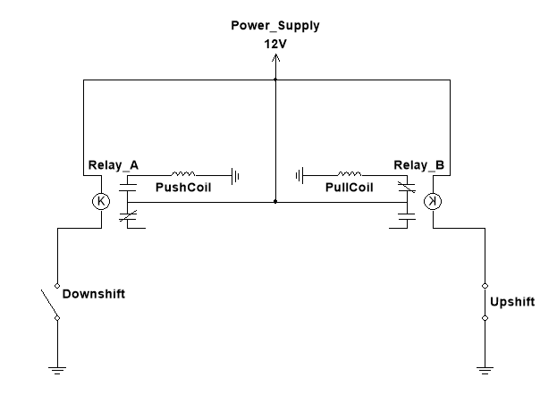
Electric Power Schematic - Relay
Solenoid Actuation, Open Relay
Solenoid Actuation, Closed Relay

Slide 21
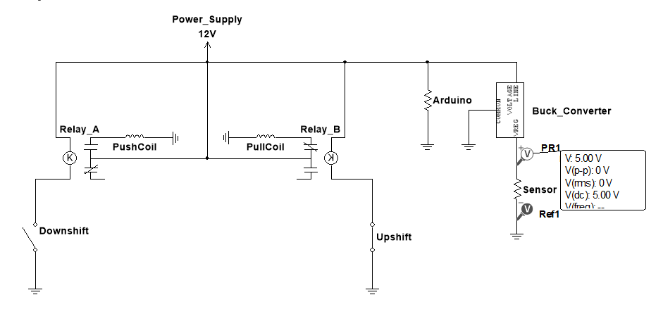
Electric Power Schematic (with all loads)
Complete Electric Power Overview

